Slide 1


Dairy Express
Presented By-
Mahendra Rajendra Kolhe(229042)
Sujay Mathane (229099)
http://www.free-powerpoint-templates-design.com

Slide 2
Points to be discussed
Screenshots
Specification
Conclusion
Introduction
Motivation
Disadvantages
Future Enhancement
References
Advantages
S/W and H/W
Requirement
Objectives
UML Diagrams

Slide 3
Introduction
This Dairy Express App project will basically be an easy-to-use web application that will allow customers to easily purchase and order products for delivery. It is basically for providing a platform for registering users, categories, products, managing stocks and orders and an end-to-end system from order-to –delivery-to –payment services.

Slide 4
Motivation
Now a days the system in the institute has the process of making the paper report in any department which is done manually which in turn increases the time requirement.
Due to pandemic, the institute faces multiple difficulties for communicating as well as sharing required resources to the students.
Students and faculties has to go through various procedure to communicate with the institute in order to change his profile or course related details.
Students and Faculties can not get all the requirements that are necessary for the completion of their course. Hence, they require a proper platform of communication.
Student’s Online Portal will reduce institute’s as well as user’s efforts of following various procedures ,manual efforts and a beneficiary platform to get all resources at one place.

Slide 5
Objectives
The main purpose of this system, is to reduce the consumption of time during maintaining the records of college. Separate divisions are providing to maintain the records of teachers, students. Our System also procure an easy way not only to automate all functionalities of a college, but also to procure full functional reports to top management of college with the finest of details about any phase of college.
In other words, our college portal has, following objectives:
Simple database is maintained.
Easy operations for the operator of the system. User interfaces are user accommodating and attractive; it takes very less time for the operator to use the system.
The aim is to design a college website which implant update information of the college that should improve expertness of college record management.

Slide 6
Technology Used:
This project discussed the tool and technology used in developing the proposed system (the system has a front end by REACT to display the content structure and a back end of database using MySQL and Spring Boot i.e. J2EE). A number of development methodologies were discussed and why one of the methodologies was chosen for this project. Methods used to gather the requirement specification was also discussed and how the researcher will use this as a guideline in developing the proposed system.

Slide 7
UML Diagrams

Slide 8
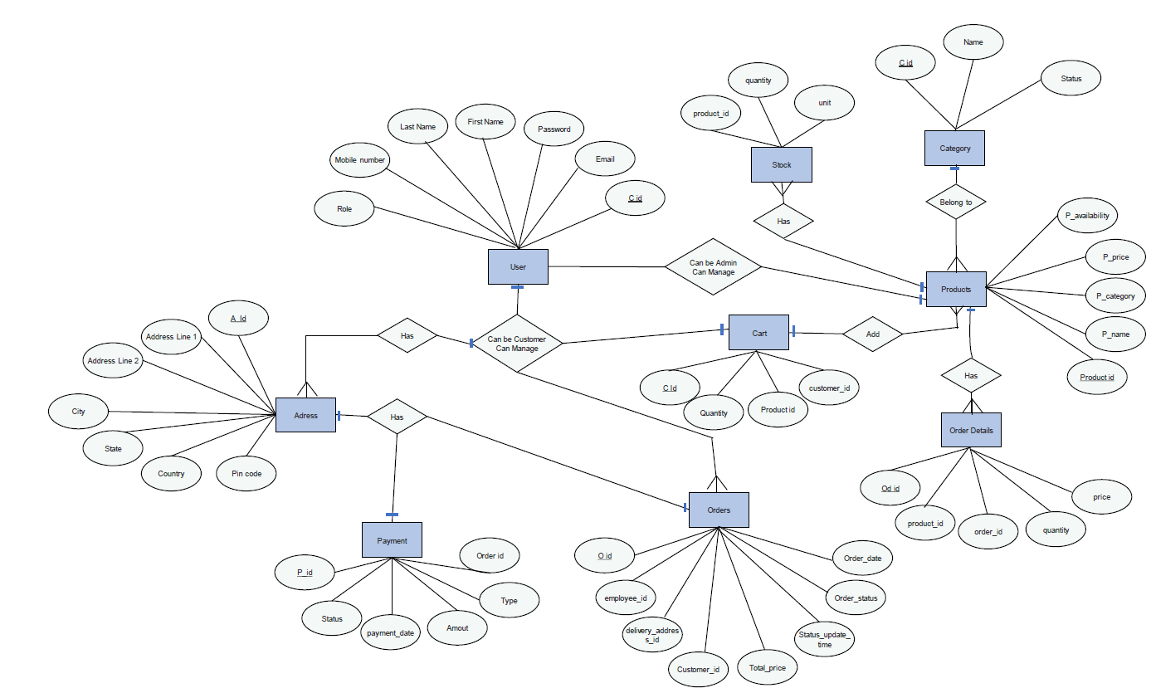
E-R Diagram

Slide 9
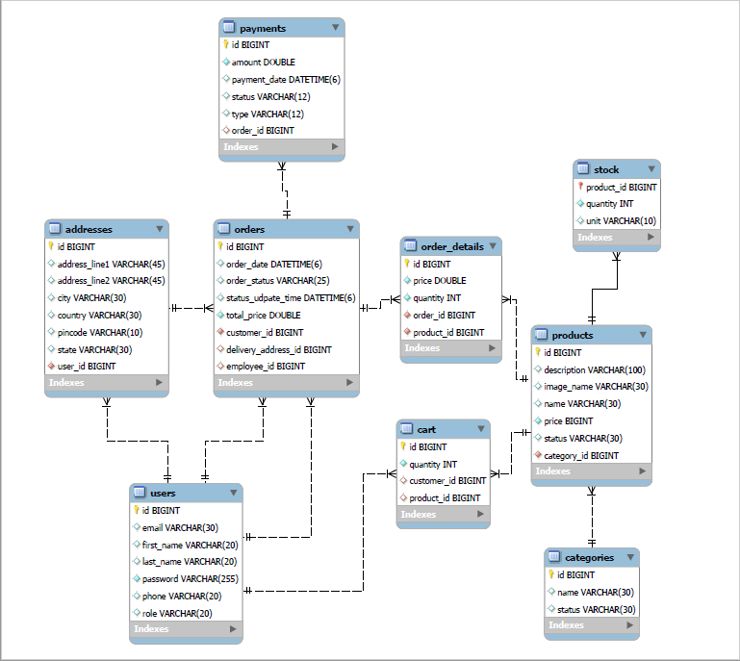
E-R Diagram(MySQL Auto generate)

Slide 10
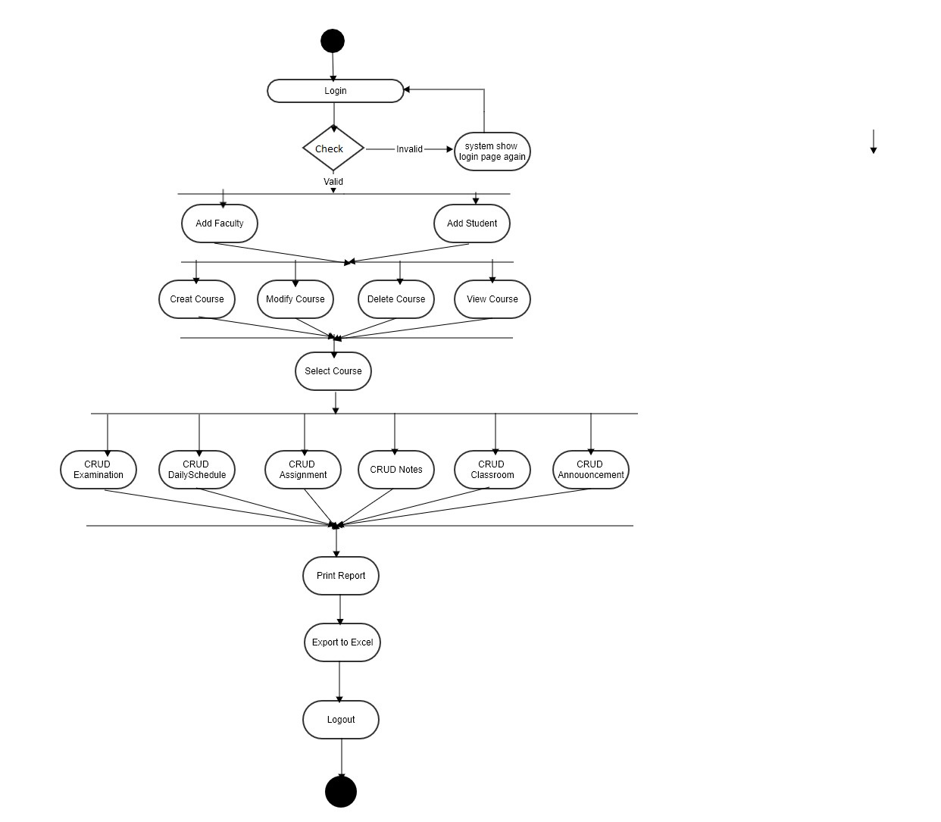
Activity Diagram Of Admin

Slide 11
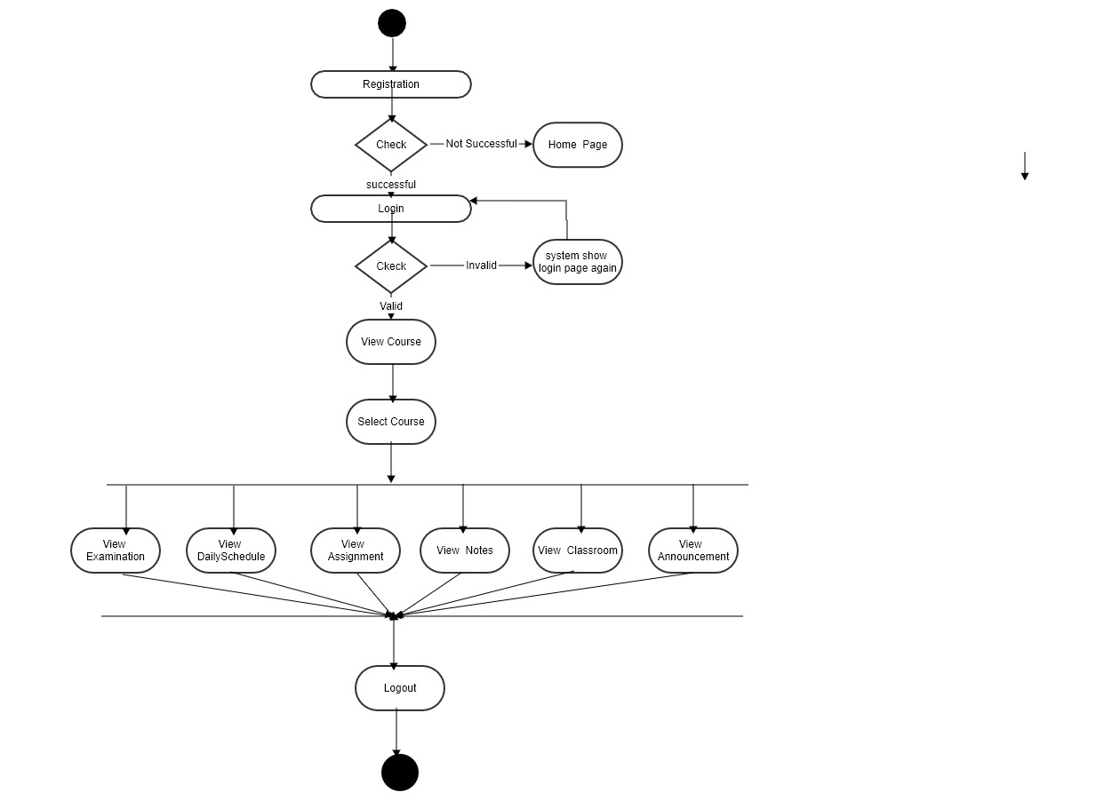
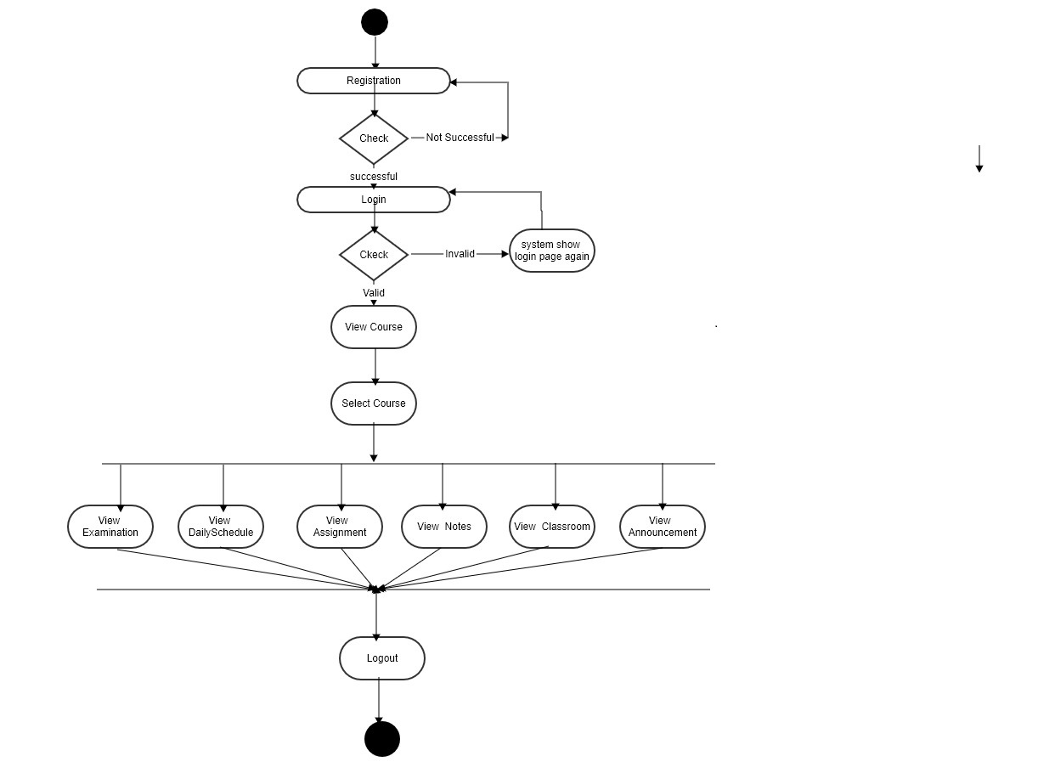
Faculty Activity Diagram
Student Activity Diagram

Slide 12
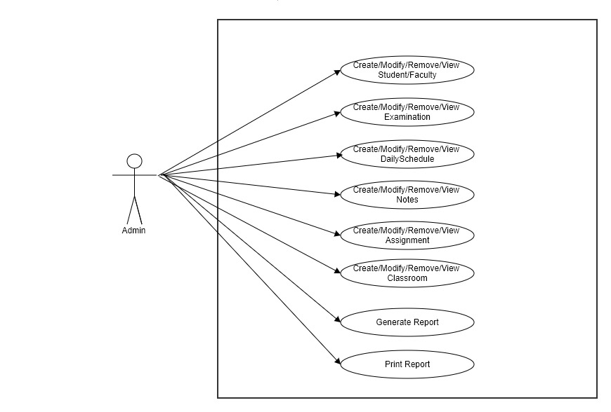
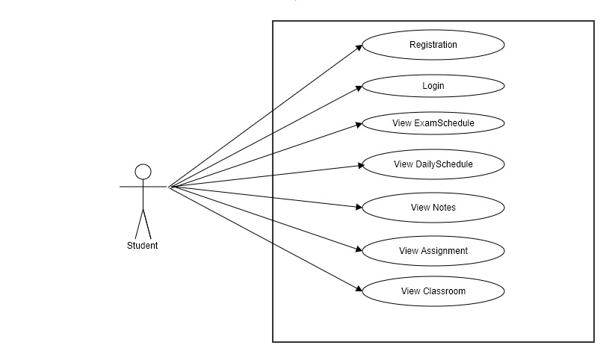
Admin UseCase
Diagram
Student/Faculty
UseCase Diagram

Slide 13
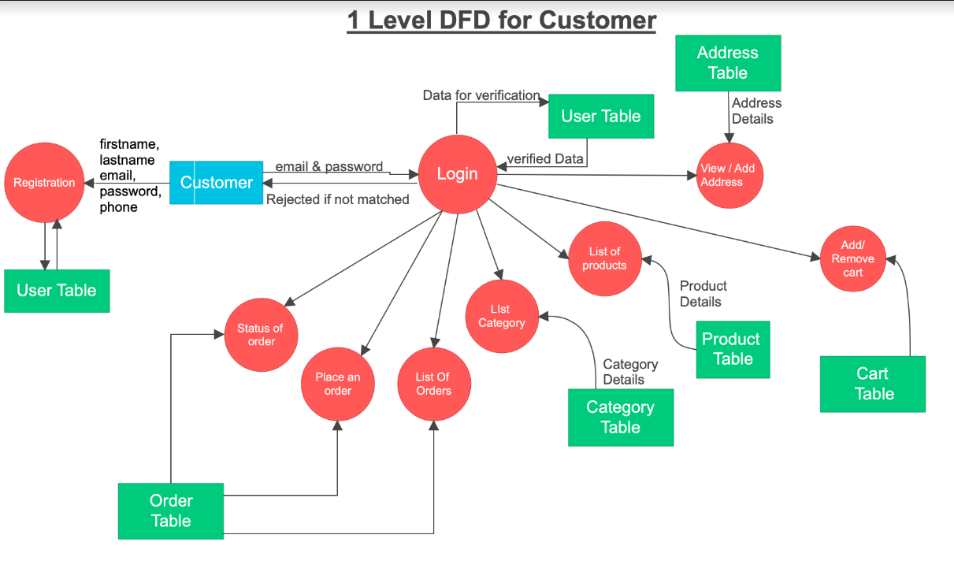
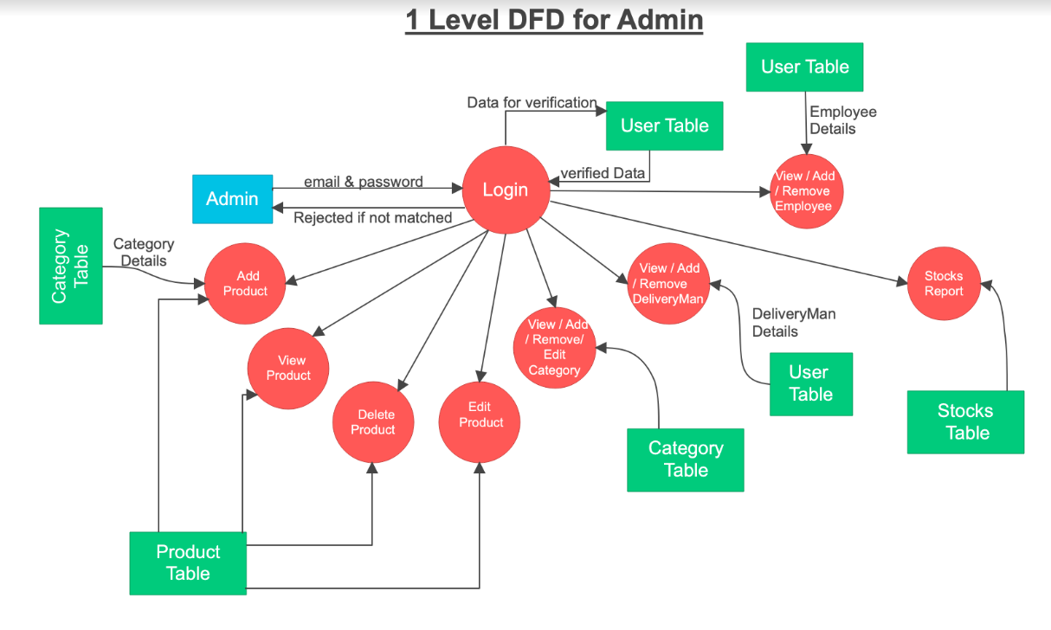
DFD Diagram
Level Two
Level Zero
Level One

Slide 14
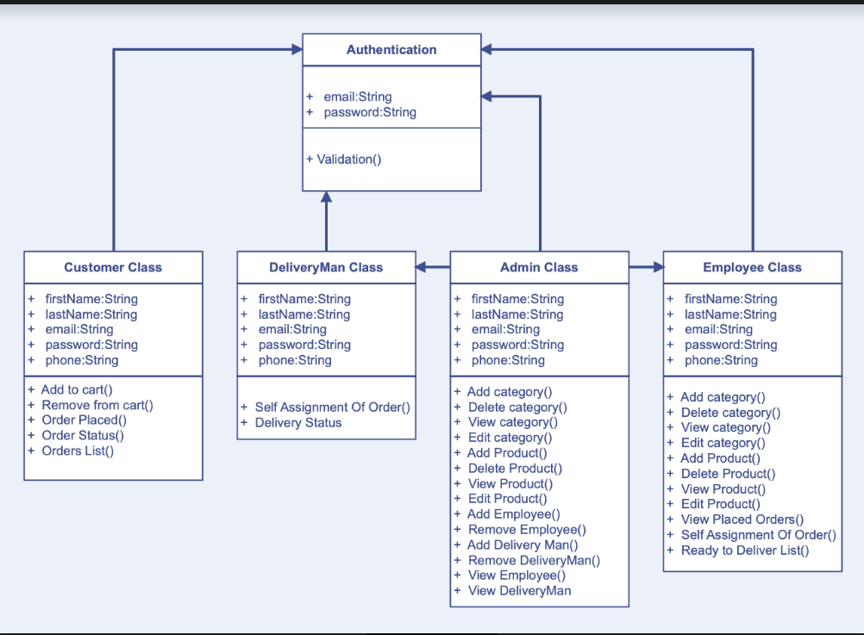
Class Diagram

Slide 15
Screen Shots

Slide 16
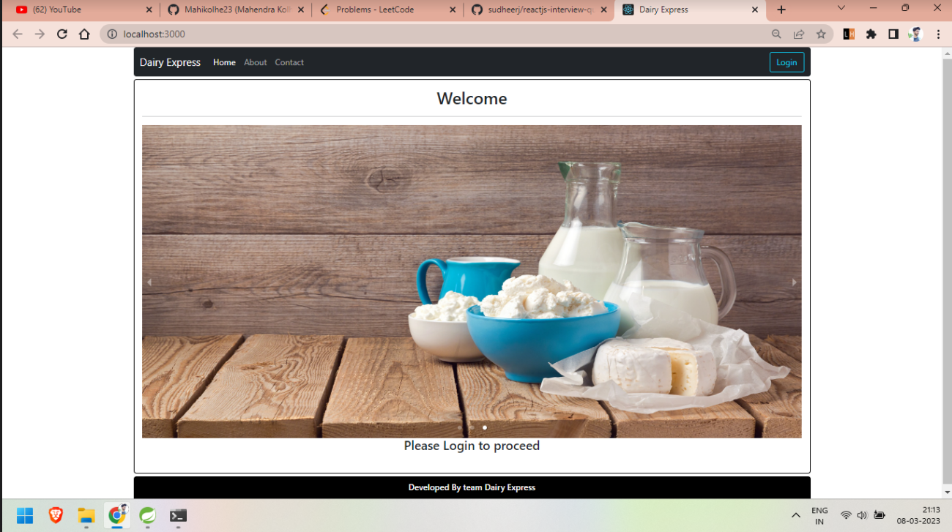

Slide 17
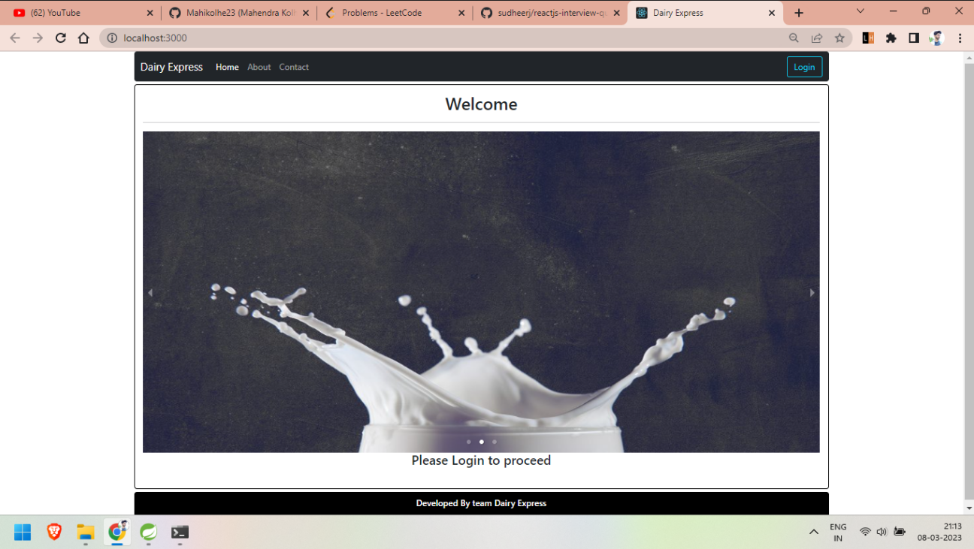

Slide 18
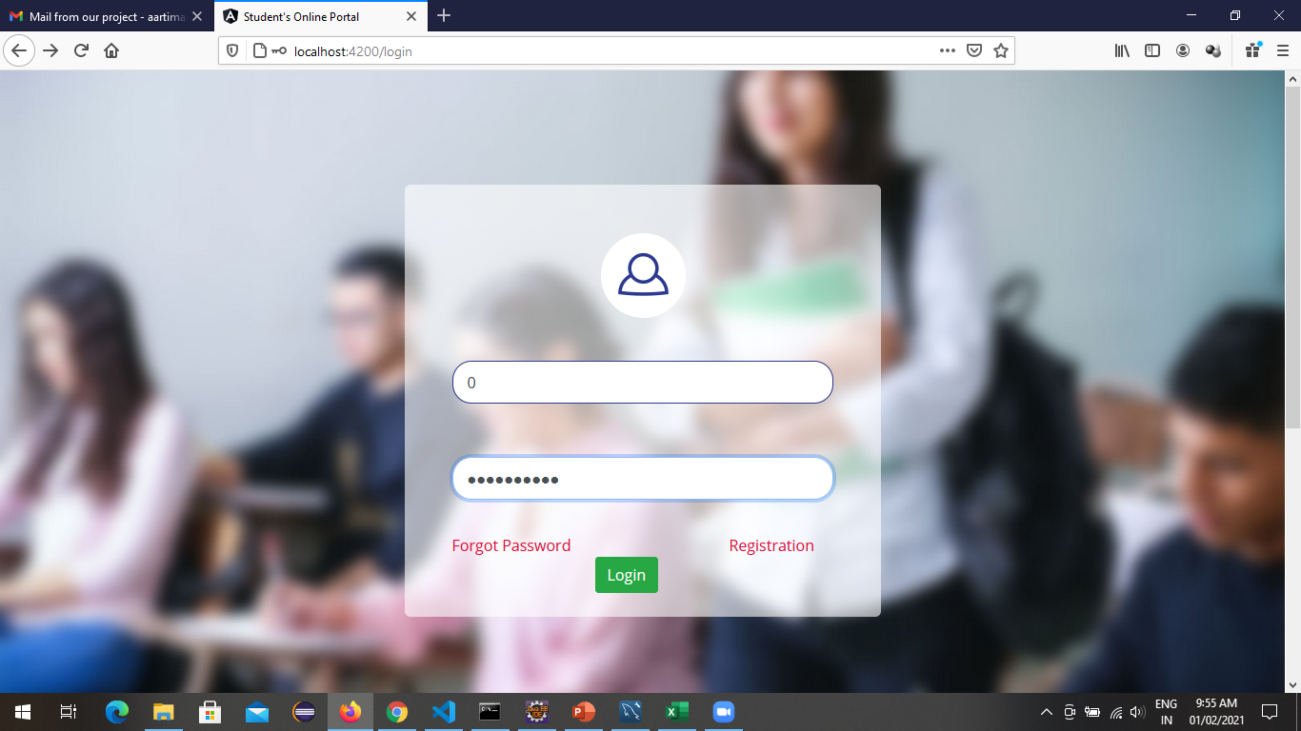
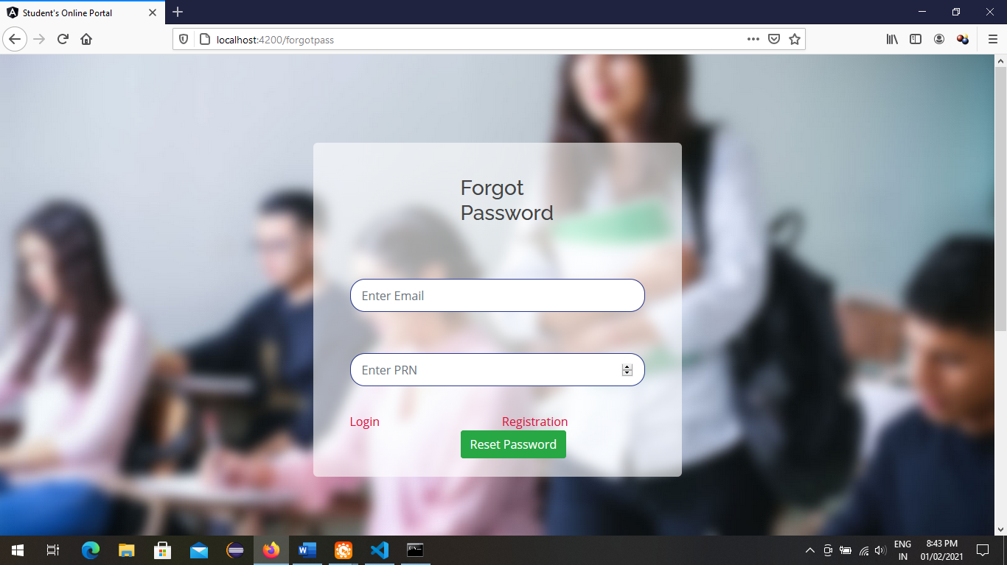
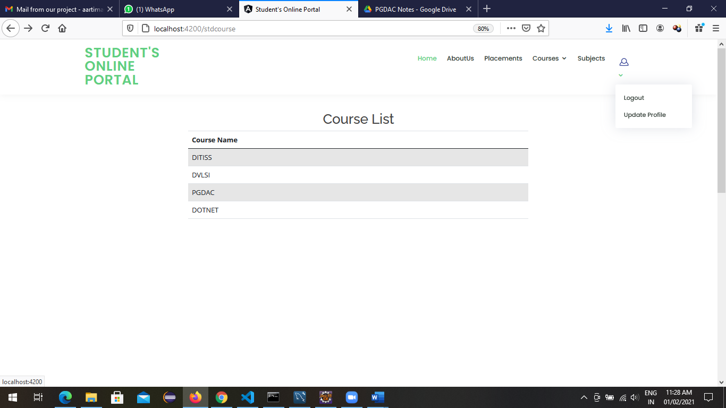
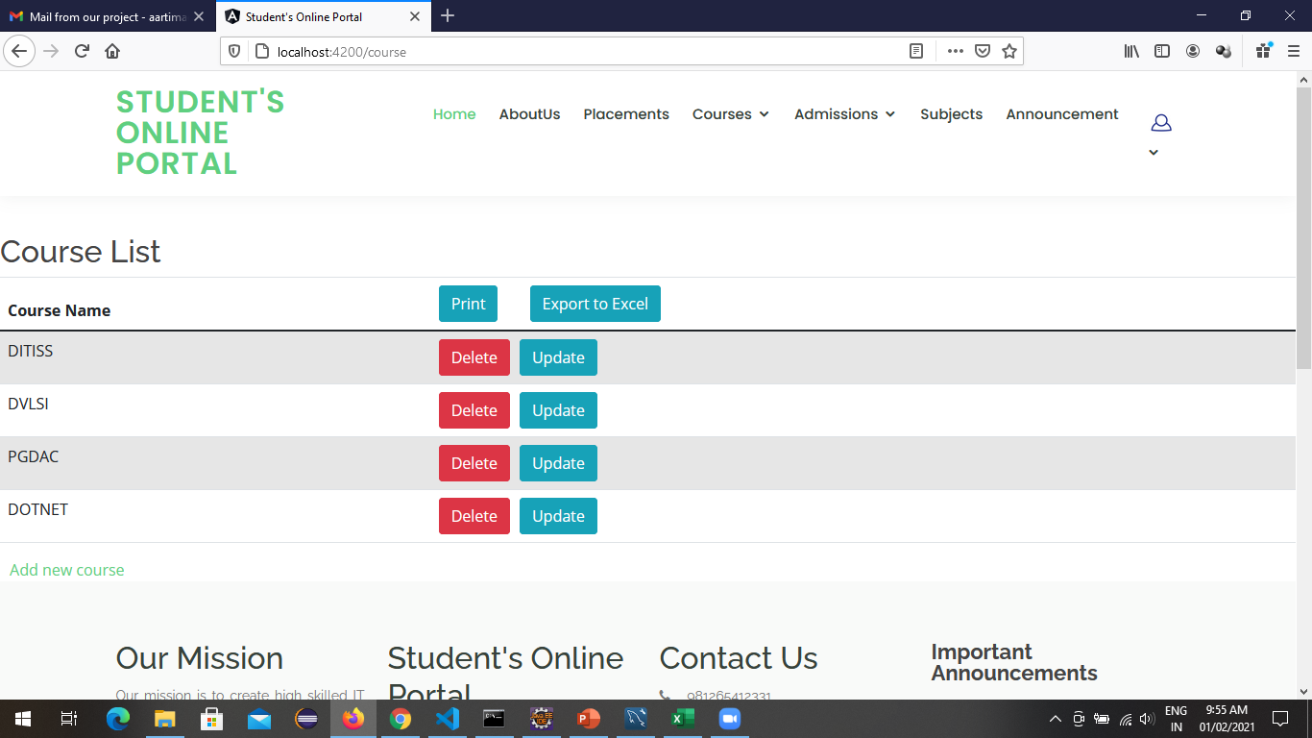

Slide 19
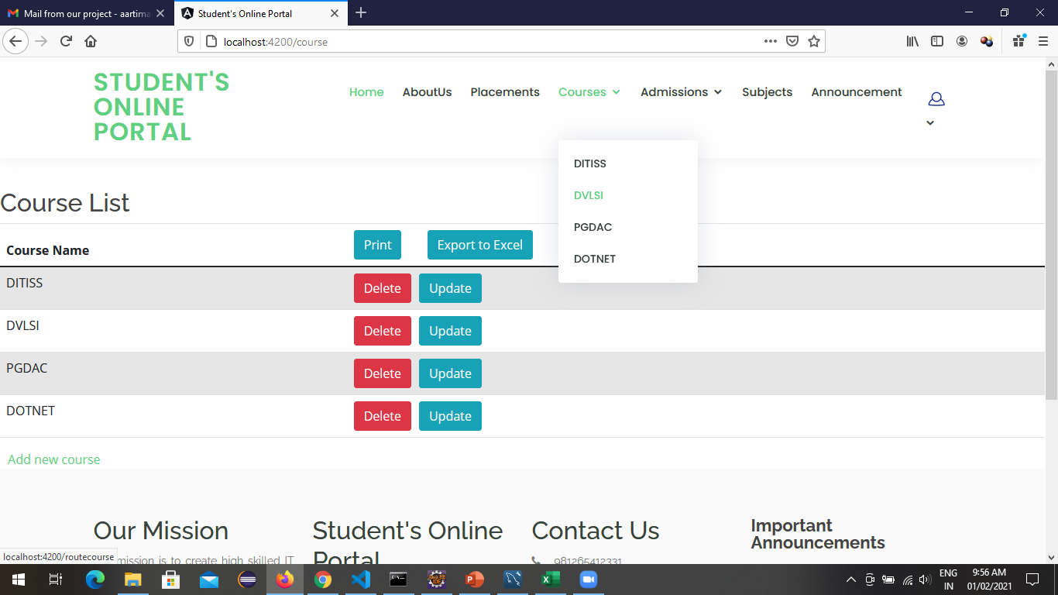
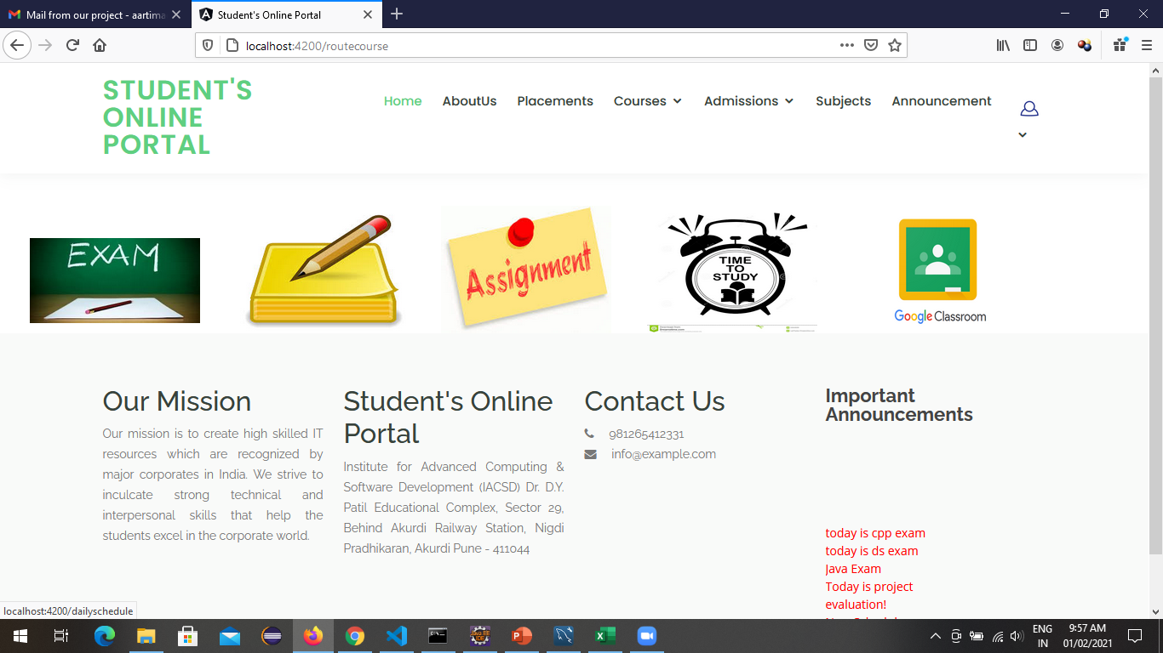
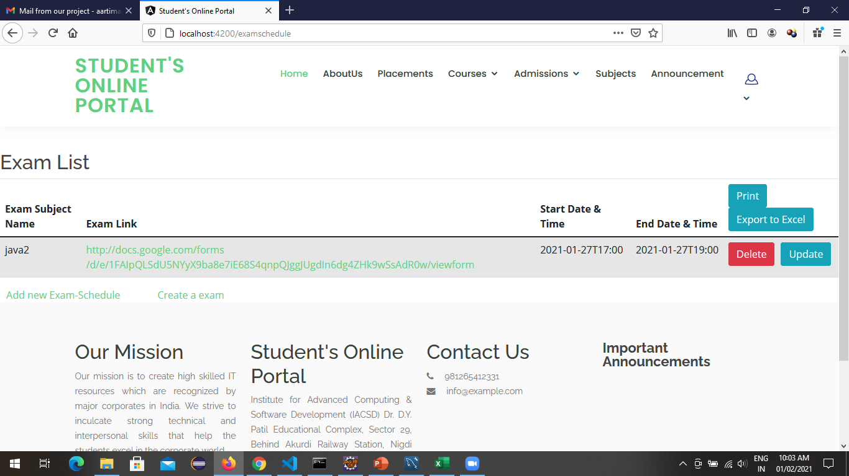
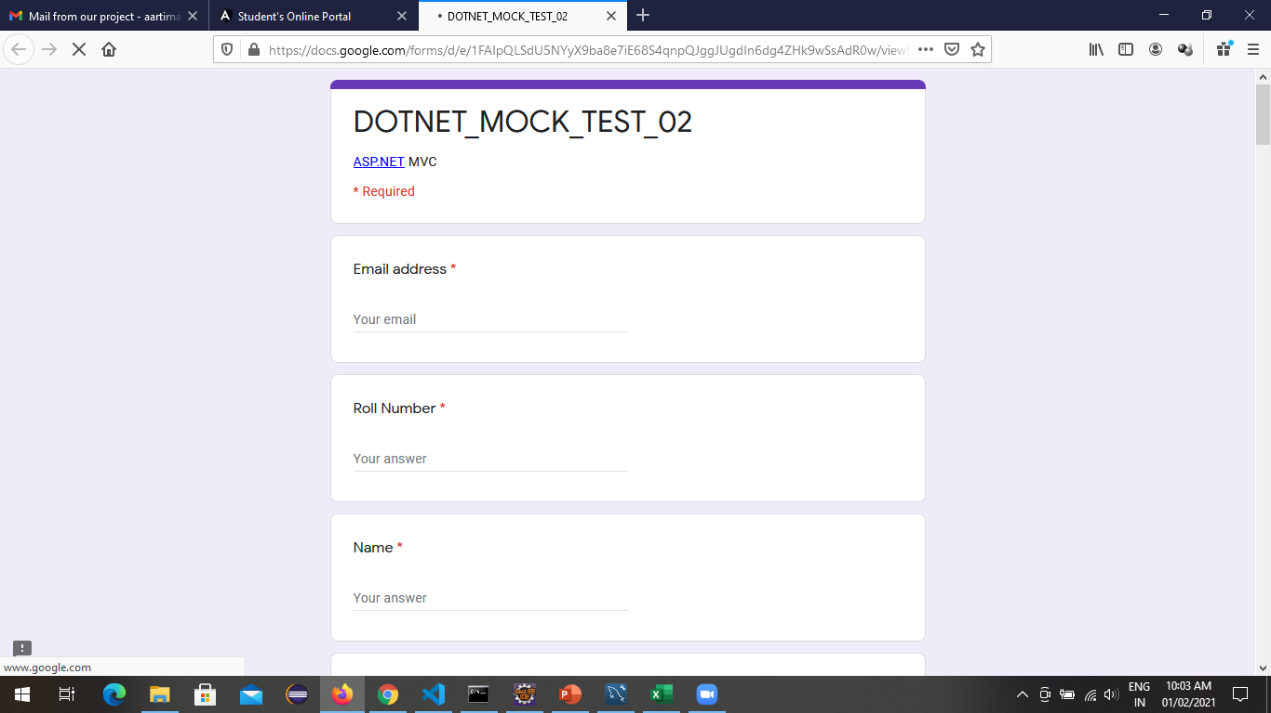

Slide 20
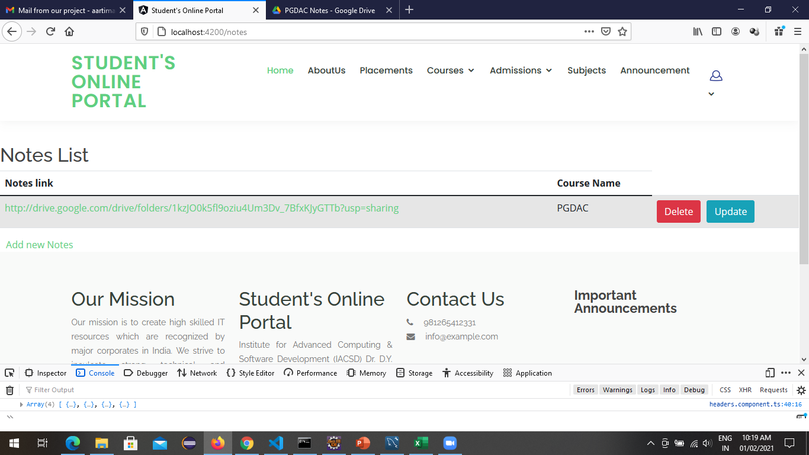
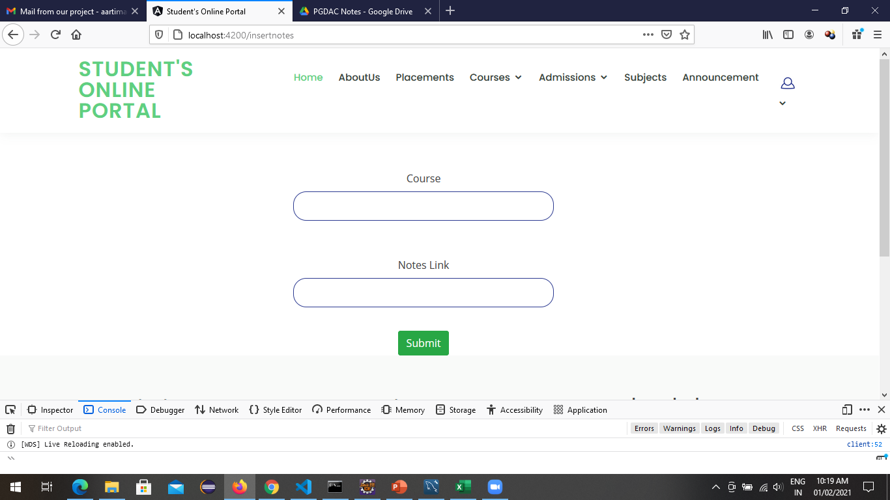
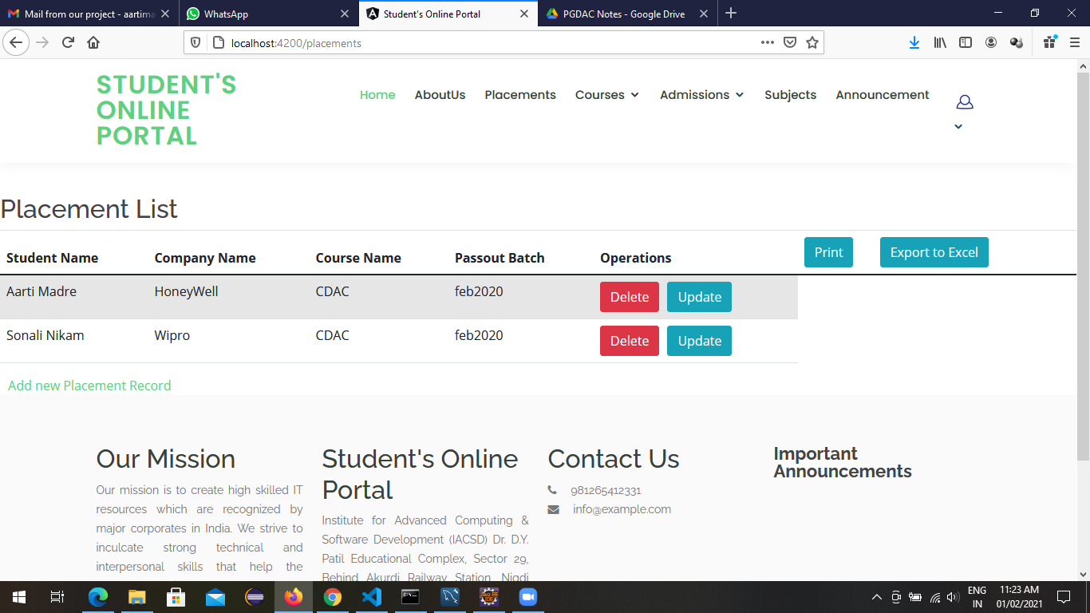
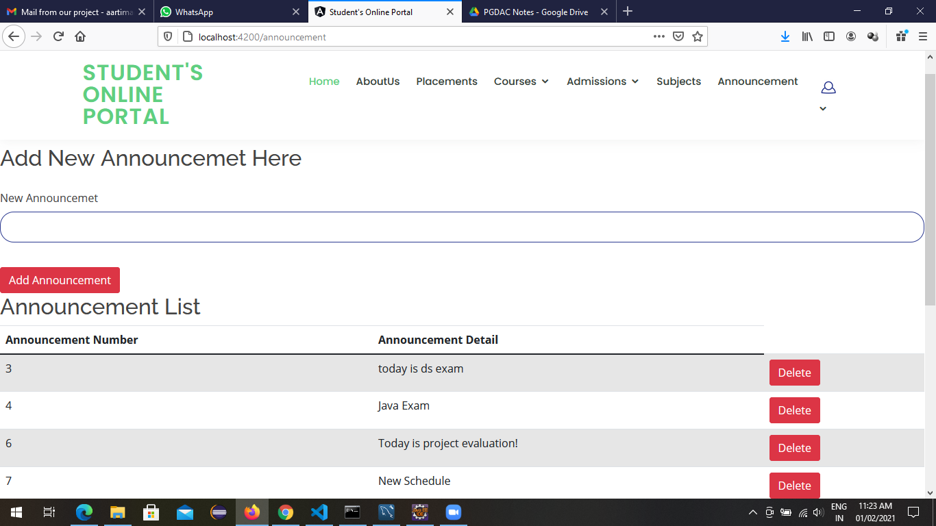

Slide 21
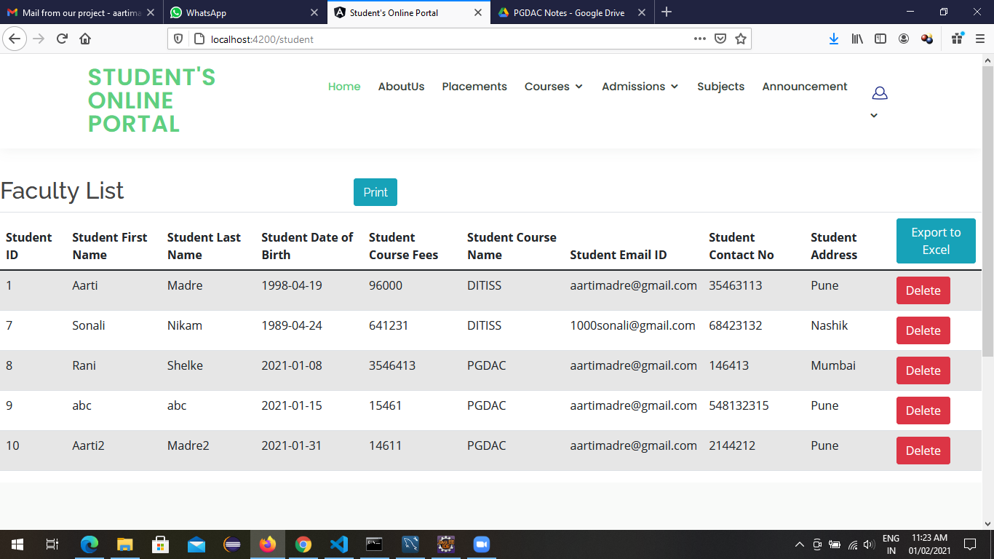
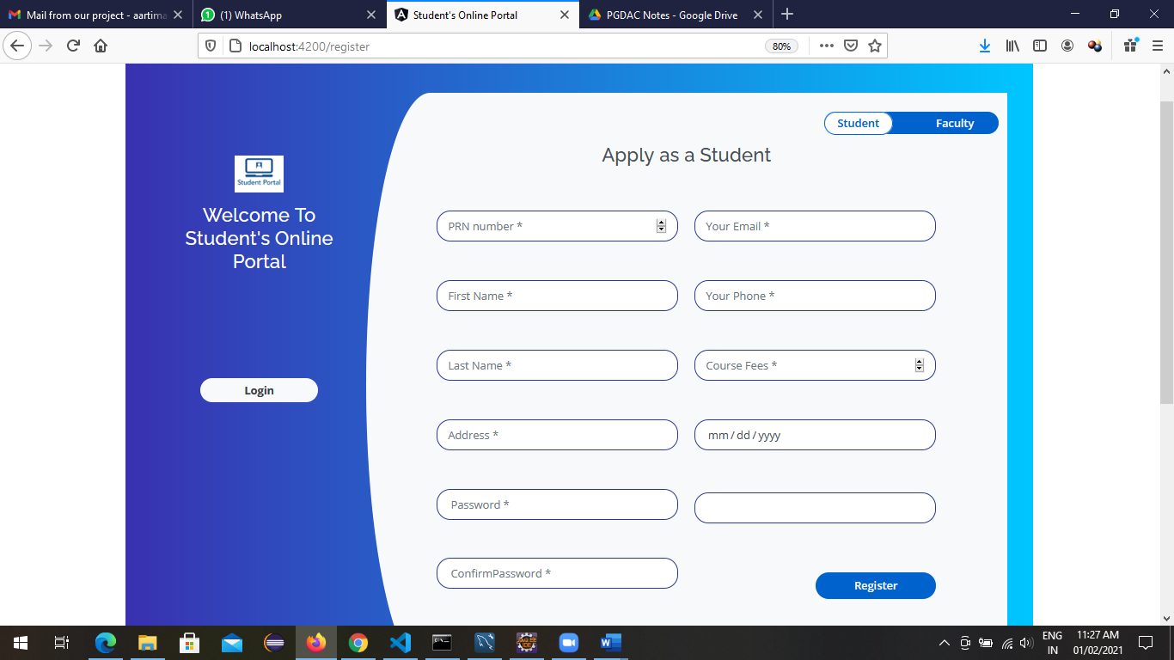
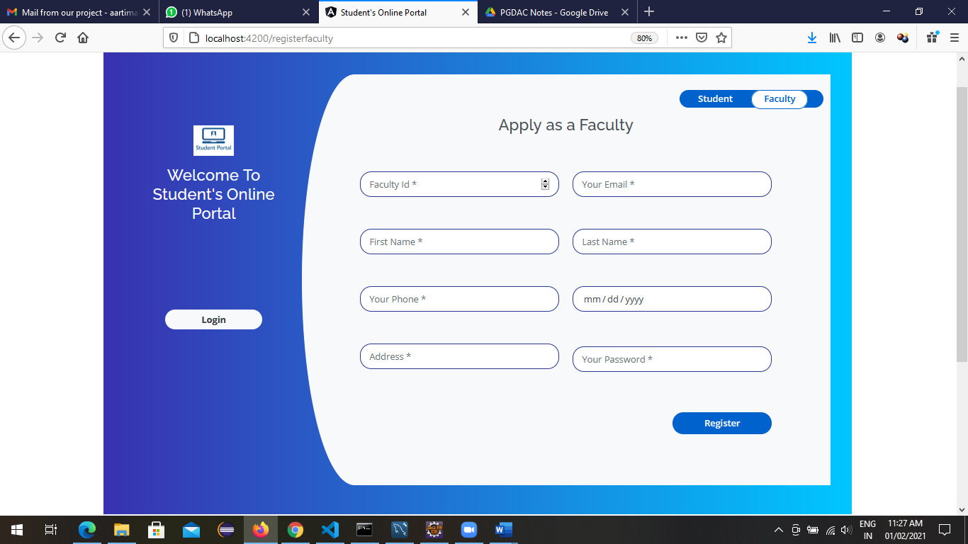

Slide 22
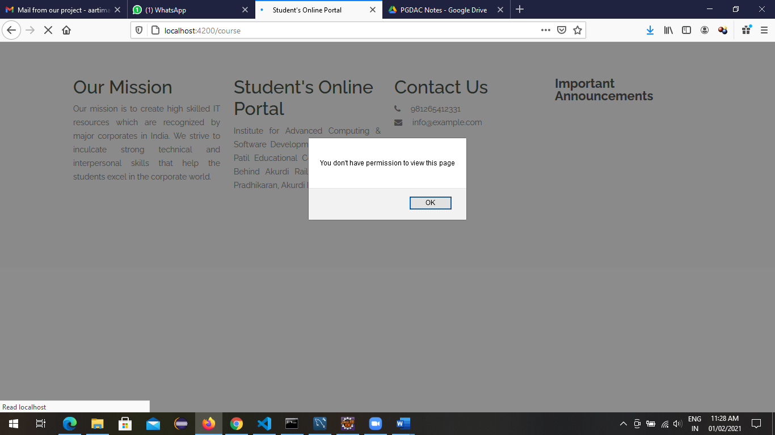
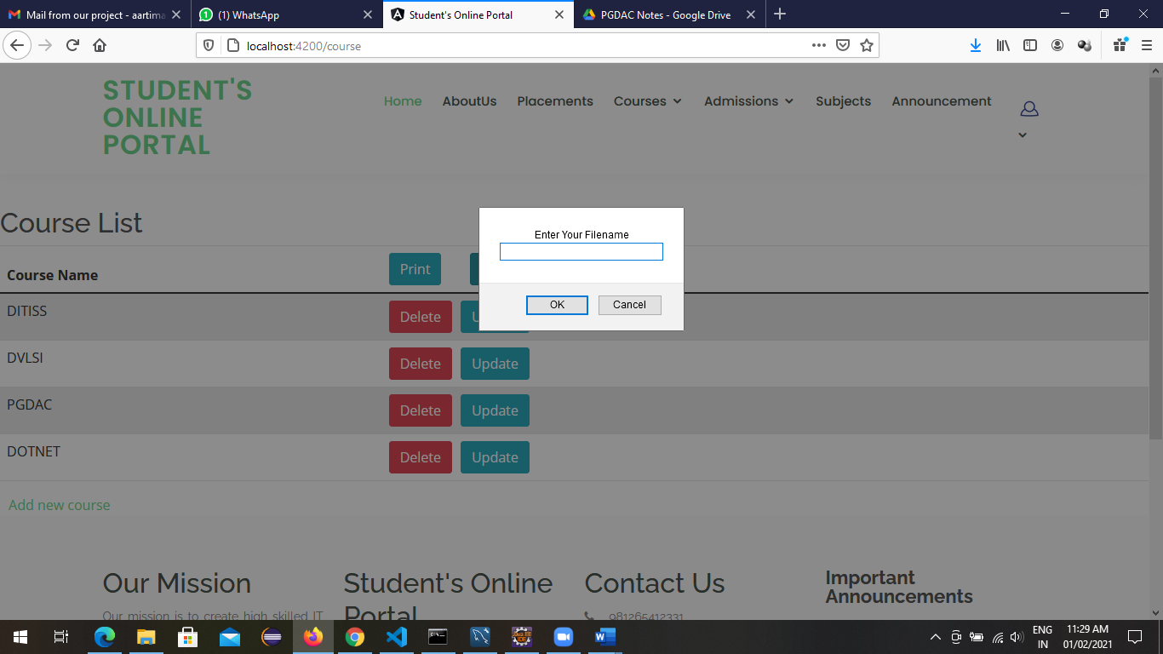
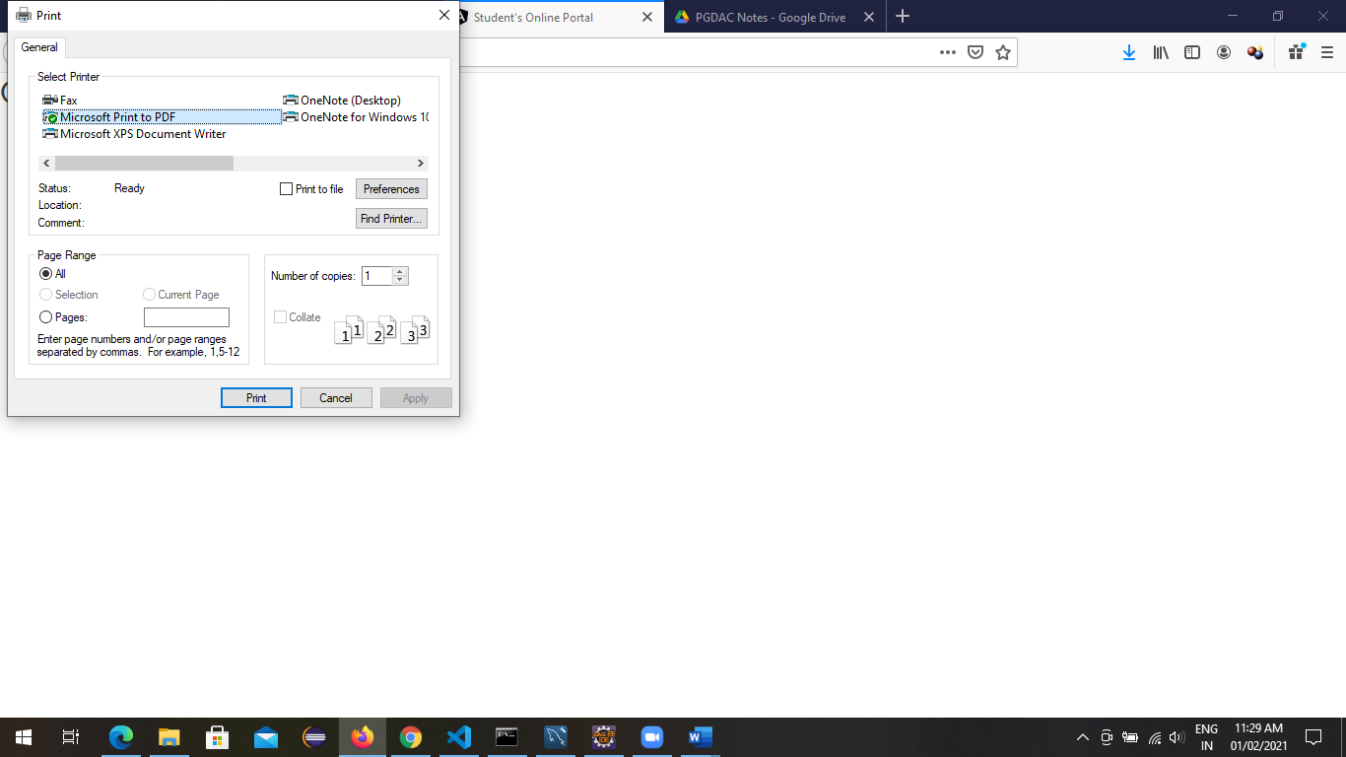
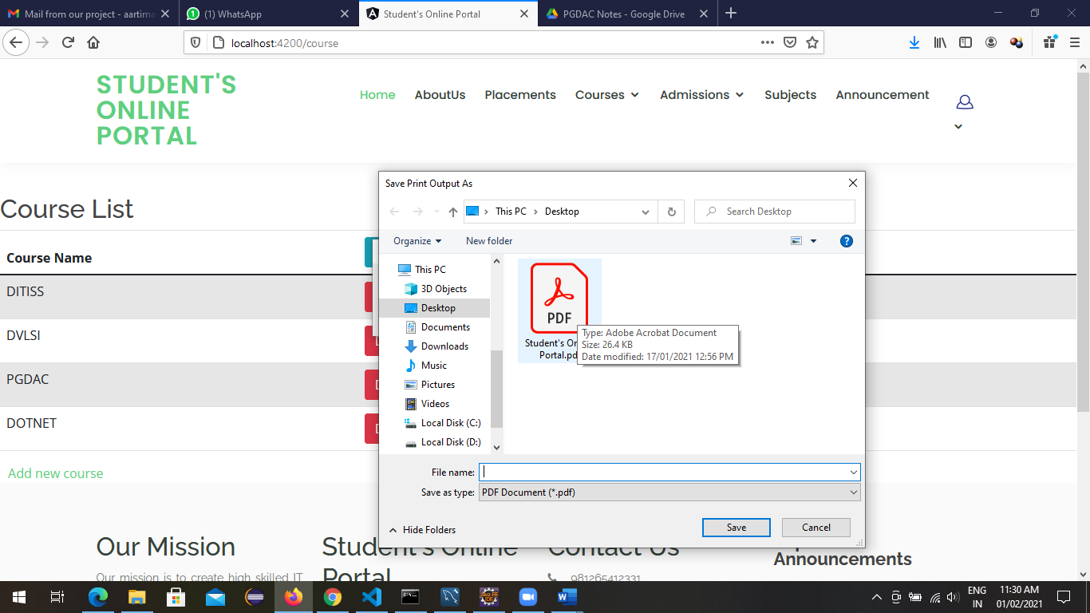

Slide 23
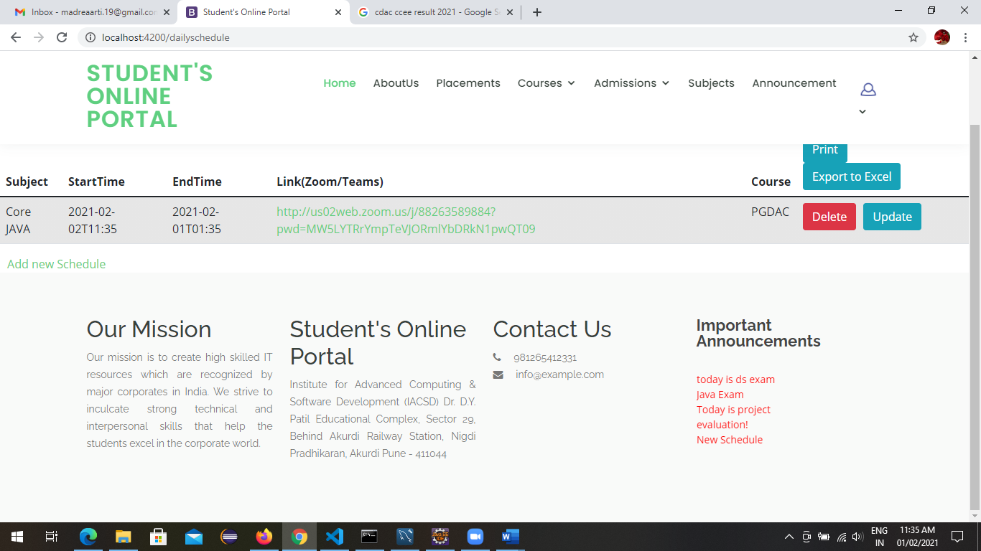
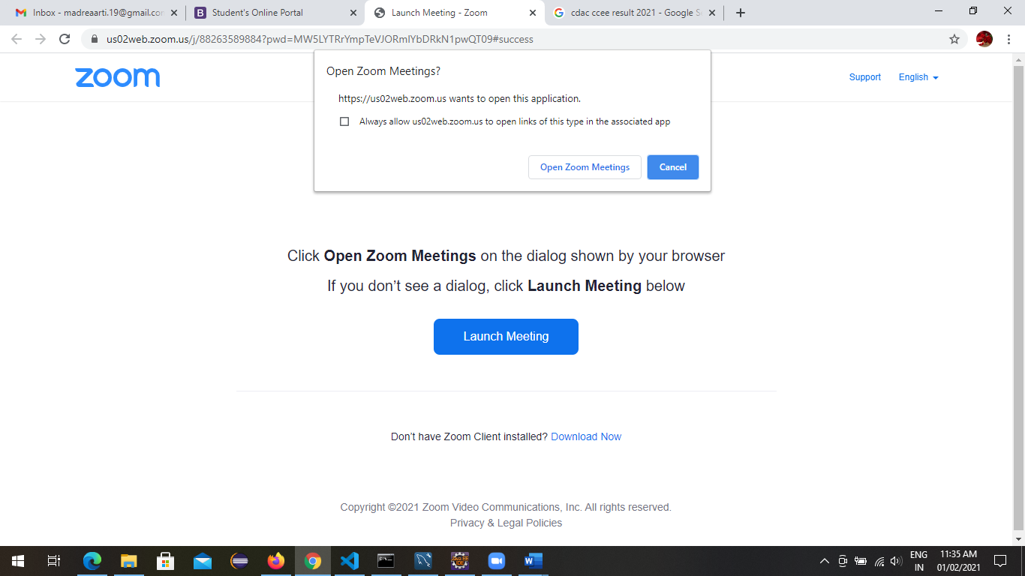
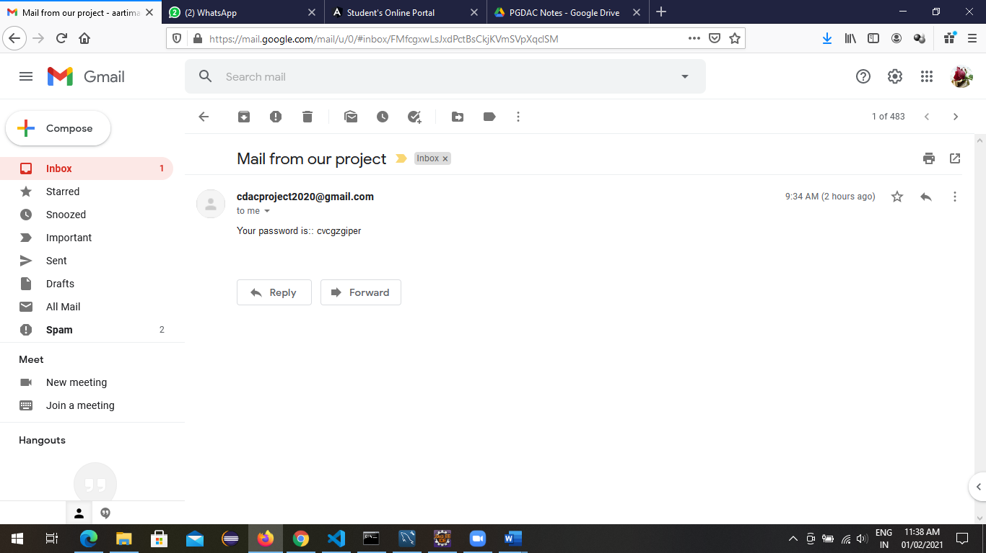
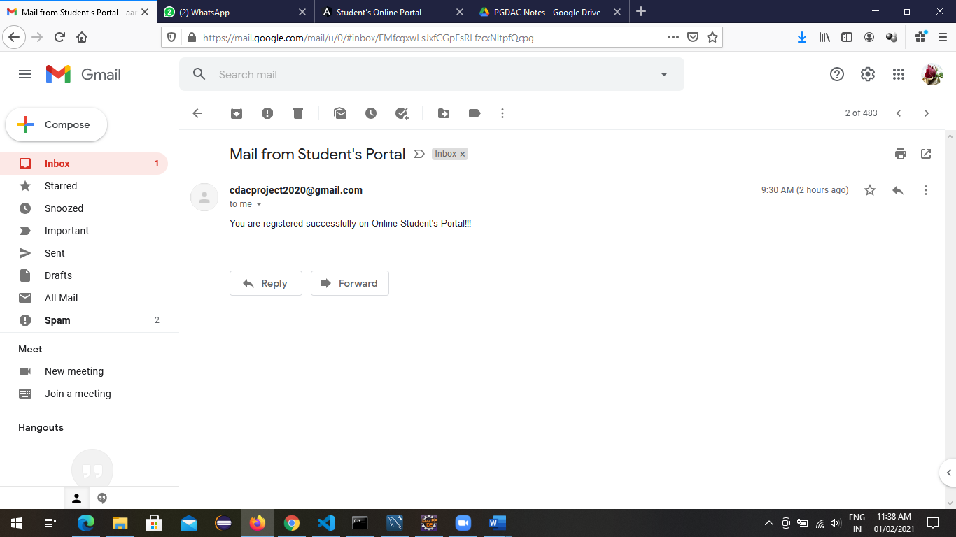

Slide 24
Specification
This project discussed the tool and technology used in developing the proposed system (the system has a front end by REACT to display the content structure and a back end of database using MySQL and Spring Boot i.e. J2EE). A number of development methodologies were discussed and why one of the methodologies was chosen for this project. Methods used to gather the requirement specification was also discussed and how the researcher will use this as a guideline in developing the proposed system. .

Slide 25
S/W and H/W Requirements
Server Side:
Processor: Intel® Xeon® processor 3500 series
HDD: Minimum 500GB Disk Space
RAM: Minimum 4GB
OS: Windows 10, Linux 6
Database: MySQL
Client Side (minimum requirement):
Processor: Intel Dual Core
HDD: Minimum 80GB Disk Space
RAM: Minimum 2GB
OS: Windows 7, Linux

Slide 26
Advantages
Managing student information.
Effortless Communication.
Lesser time requirement to maintain and manage records of student and faculty.
Automatic record generation of day to day schedules, exams, courses and assignments.
Paper work is reduced due to record stored into excel sheets.
All requirements at one platform.

Slide 27
Disadvantages
No online payment facility given, hence payment must be done manually. But this can be done as future enhancement.

Slide 28
Conclusion
Currently small and medium scale Dairy Express don’t have synchronization between their task and customer.
By making online milk product selling we have solved the problem
from Dairy Express and customer end and more convenience is added to the existing system.
In future scope this system will be available with large scale database and can accommodatemany customers and stores.
To find the location of new customer for that particular city we can add Google API to find nearest Dairy Express.
This system can also be developed on mobile application so that it can be access remotely.

Slide 29
Future Enhancement
For future enhancement we will provide one interface for a person who wants to sell their milk product on our website, So that they can also sell their products without any Hussle.
The software is flexible enough to be modified and implemented as per future requirements.

Slide 30
References
http://www.ijcstjournal.org/volume-7/issue-1/IJCST-V7I1P4.pdf
https://bootstrapmade.com/mentor-free-education-bootstrap-theme/
https://www.javatpoint.com/java-mail-api-tutorial
https://www.w3schools.com/
https://angular.io/docs
https://javaee.github.io/javaee-spec/javadocs/

Slide 31
THANK YOU

